Slide 1
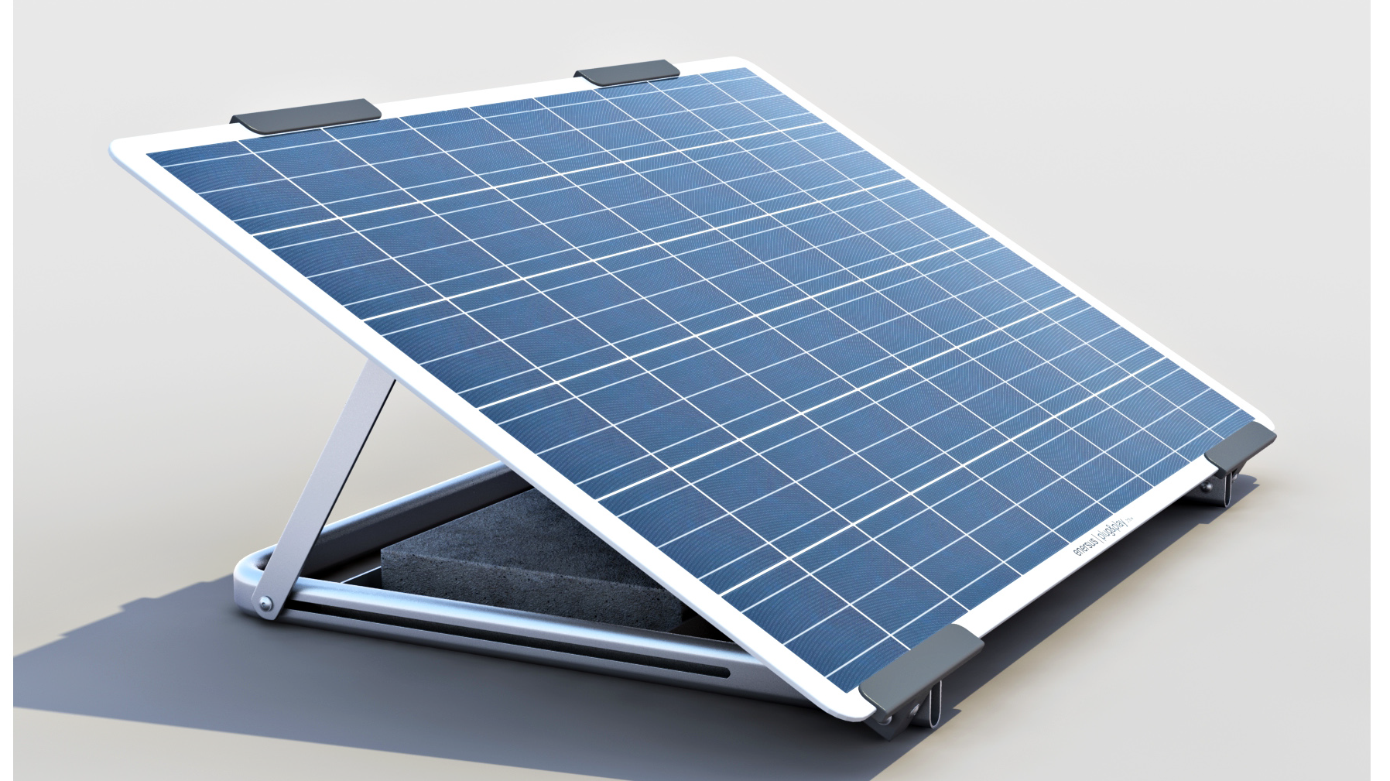
Solar Power Design for The Roadside Unit

Slide 2
Overview
Solar power components
System power consumption
Solar Panel Sizing
Battery Sizing
Charge Controller
Installation concept

Slide 3
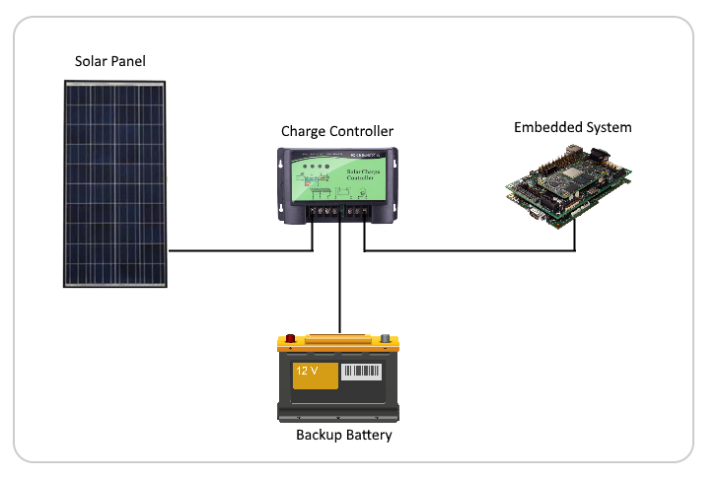
Solar Power Components
12V Solar Panel, 8-18V depending on sunlight
Charge Controller, Max Power Point Tracking (MPPT)
5V Embedded System as load
12V, SLA or LiFePO4

Slide 4
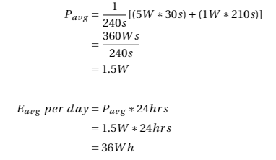
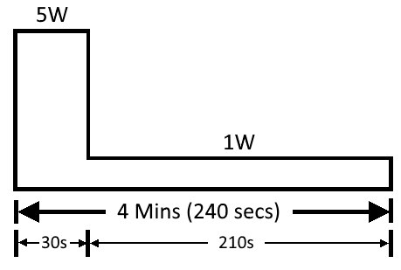
System Power consumption
5 watts while transmitting data, 1W while at idle
Therefore, the roadside system on average consumes 36Wh per day
Fig 1: Power consumption cycle of the roadside unit

Slide 5
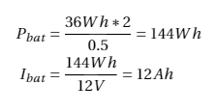
Battery Bank Sizing
System Power consumption = 36Wh / day
We want the system to function even with 2 continuous days without sun
We want to discharge only to 50% to prolong life of battery
Assuming 21°C and 12V battery
Therefore, the battery must have at least 144Wh capacity (12Ah at 12V)
Note capacity should be ~1.5-2 times the above capacity for sub zero temperatures due to charge performance

Slide 6
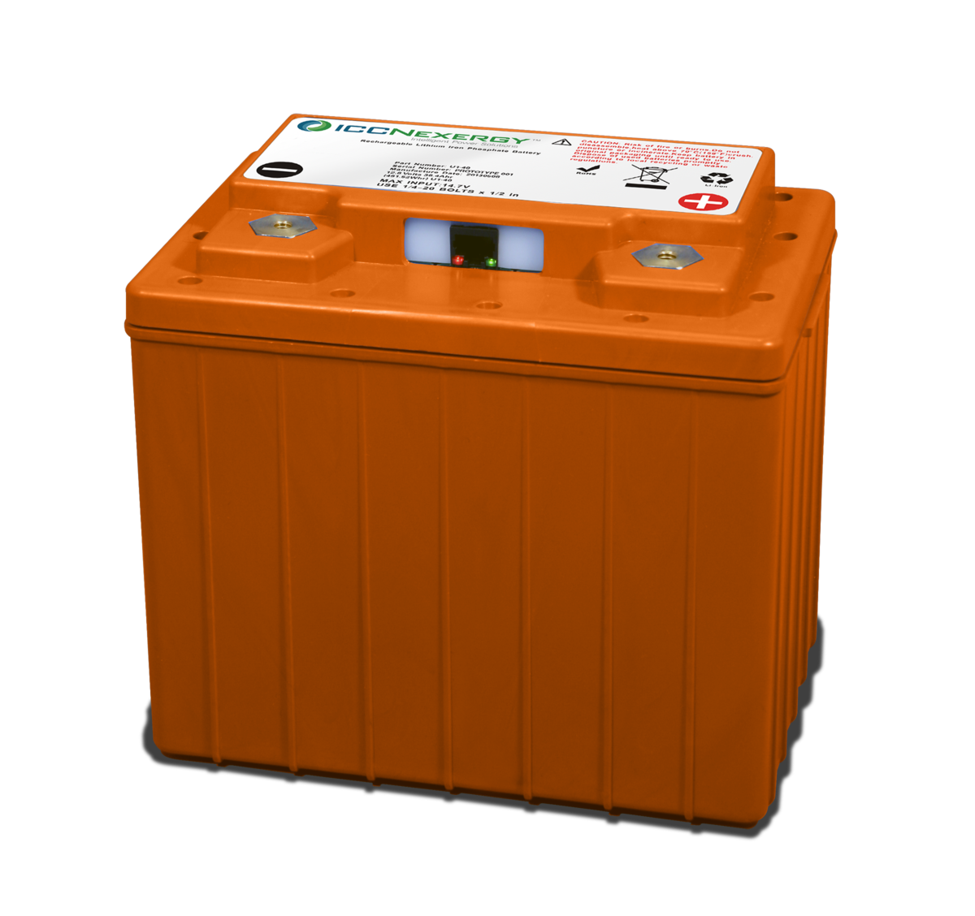
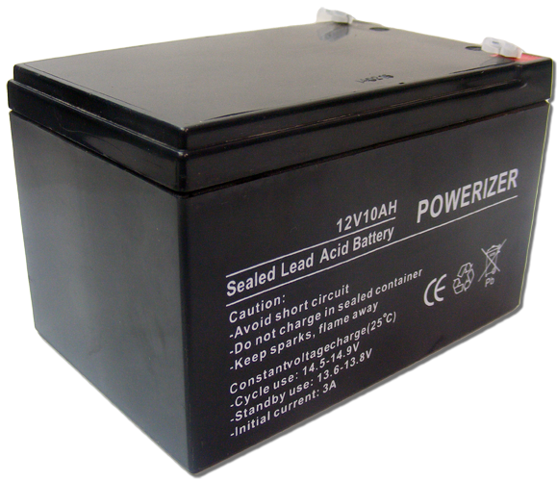
Battery Comparisons
LiFePO4
Sealed Lead-Acid
Popular in vehicle applications
Stable and safer then LiCoPO4
>10 year lifetime, 2000 cycles
3.2V nominal until exhausted
70% apparent capacity at -20°C
Impractical charge rates below freezing (0.02-0.05C), would need a thermal blanket
Big and sluggish, takes a long time to fully charge (70% in 5-8 hours)
70% retention capacity after 5 years @ 21°C
Can charge at 0.3C between -20°C to 50°C

Slide 7
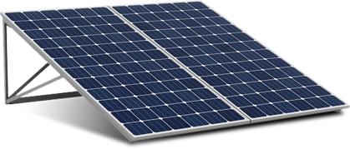
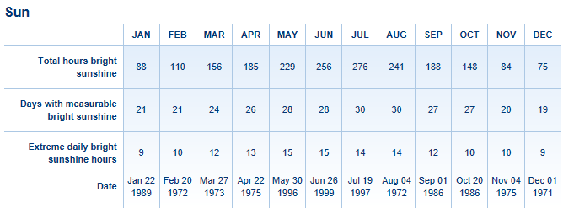
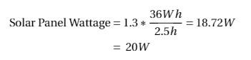
Solar panel Sizing
Sizing based off power consumption and worst month of sunshine in area
Worst case in Toronto is December
2.5 hours average sun per day
Add 30% for inefficiencies
https://www.theweathernetwork.com/forecasts/statistics/suncloud/cl6158350/caon0696
Therefore, a 20W solar panel is needed.

Slide 8
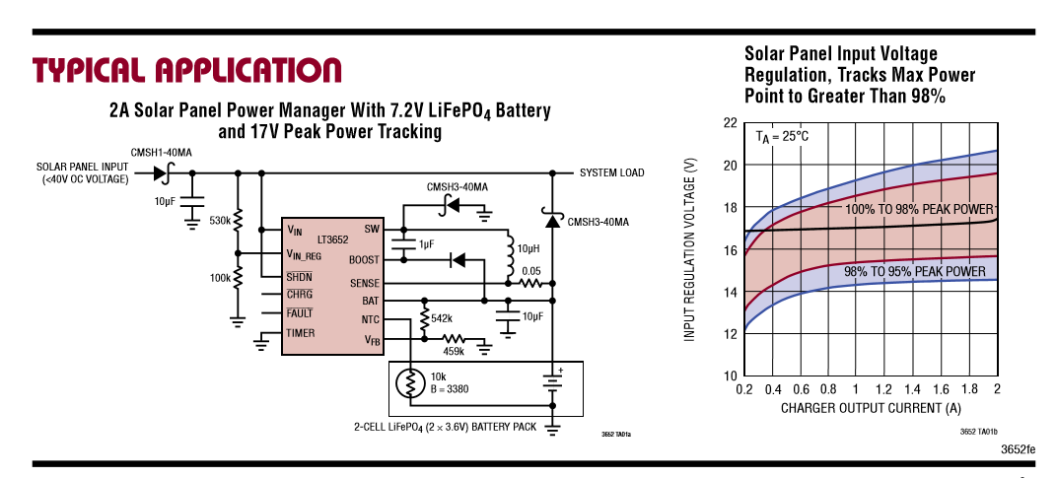
Charge Controller
LT3652 – Power Tracking 2A Battery Charger for Solar Power
5-32V input, 2A charge rate
Accommodates LiPo, LiFePo4, and SLA
Employs MPPT (Maximum power point tracking), which adjusts the panel voltage to match the battery charge voltage for maximum power
http://cds.linear.com/docs/en/datasheet/3652fe.pdf

Slide 9
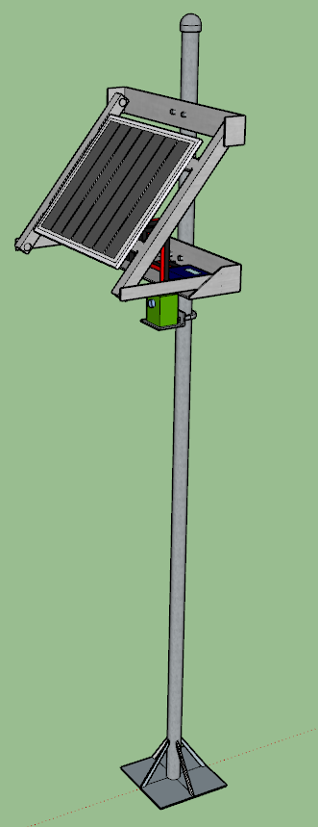
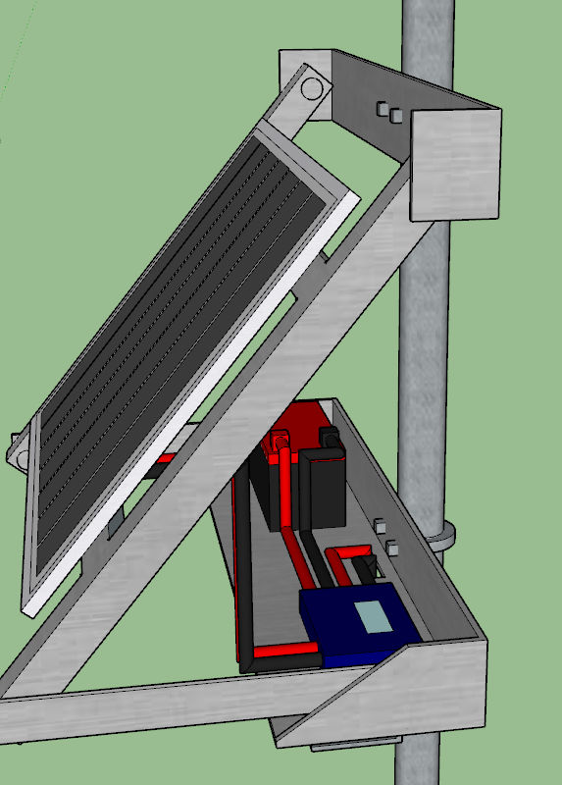
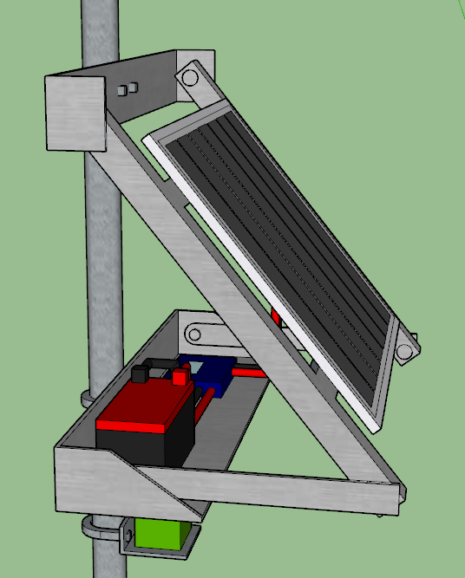
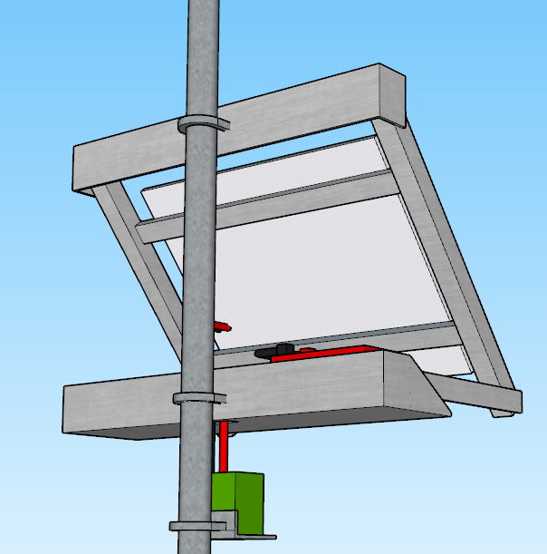
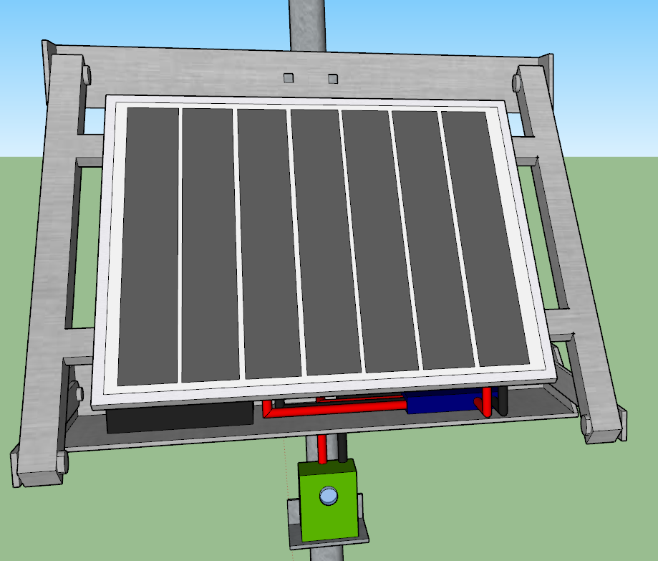
Installation Concept

Slide 10
